Slide 1

Make a “U” Turn : Extravagant to Resourceful — Team Turbo Dynamic

Slide 2

Make a “U” Turn : Extravagance to Resourceful
What Triggered the Idea!!
Realizing the importance of green practices at home or at workplace or in the society in general, can help reduce waste, conserve resources, improve air, soil and water quality, and protect ecosystems and biodiversity.
Despite being aware of the destruction, it is causing to the ecosystem, we continue indulging in production of irreversible & harmful waste products and engaging in detrimental practices.
The designed application will update the users on how we are contributing to this destruction by producing volume of harmful waste products. This application will also recommend solutions & ways to mitigate and overcome the situation.

Slide 3
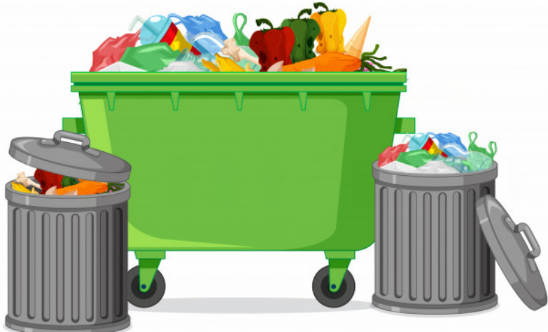
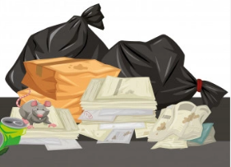
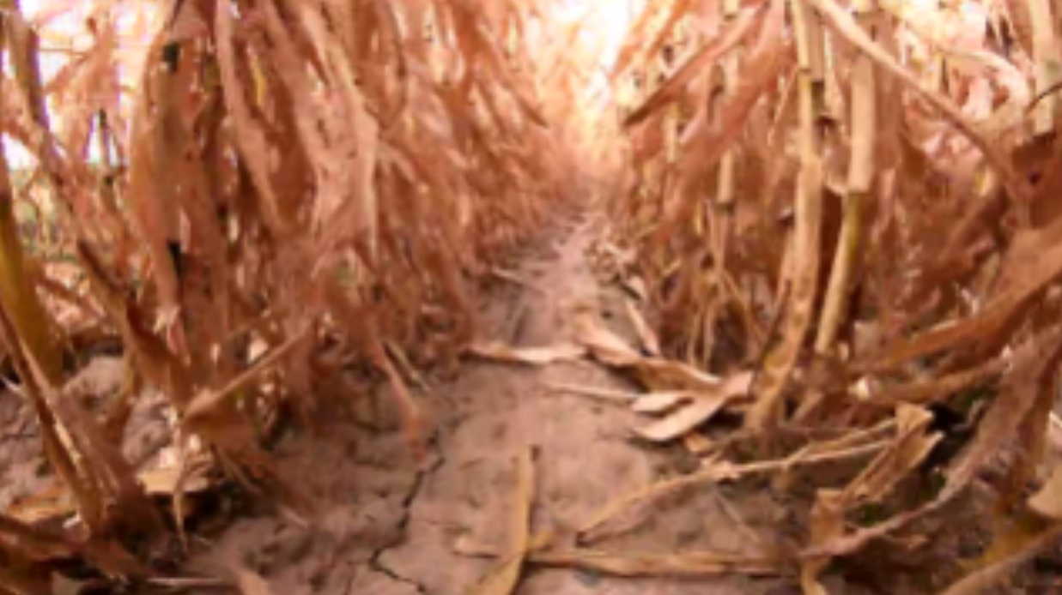

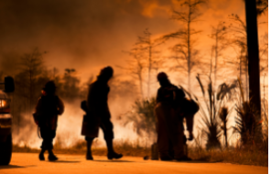
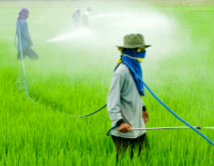

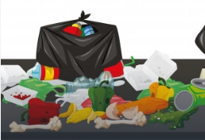
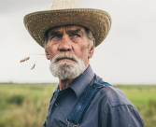
Problem Statement
Currently, about 2.01 billion metric tons of municipal solid waste (MSW) are produced annually worldwide. and 40% of waste generated worldwide is not managed properly and instead dumped or openly burned.
Wastage / burning, convert to Biogas
CO2 accounts for about 76 percent of total greenhouse gas emissions and environmental damage. with increased number of vehicles on road. World has about 47 years of oil left (at current consumption levels and excluding unproven reserves).
CO2 emission
Indiscriminate usage of chemical pesticides and fertilizers have a devastating effect on our entire ecosystem
They directly impact the helpful insects/pests
Damages soil quality (makes the soil dry and results in high water usage)
Contaminates the water
Crop to harvest / good & bad pest for the crop
Up to 811 million people are going hungry, more than 2 billion suffer from malnutrition, while 1.3 billion tonnes of food produced for human consumption is lost or wasted globally per year.
23.40 percent of people are unemployed in agricultural sector globally.
No wastage
Farmers seeking work

Slide 4
Solution Outline for the Problems
To manage waste effectively and have an alternate fuel option, we can opt for using Biogas to save our environment. The application will provide means of Selling the wasted products like food, papers, crop residue as raw material for producing Biogas (getting raw material is a challenge). Biogas producers can find the platform to easily Purchase the materials for their production.
Car pooling, is one of the options available to reduce vehicle emissions. The app will encourage car pooling by providing Bio Coins to users, which they can redeem later for purchase. For this the users have to provide valid invoice for car pooling/sharing.
The application will recommend the crop suitable to be harvested for a particular climatic conditions - based on the user inputs provided, like soil type, temperature, rainfall, and other parameters.
Application will also exhibit the list of harmful and beneficial pests for the selected crops. So that the farmers can attain the knowledge and take the judgment of using controlled pesticides.
The application will provide means of donating surplus food, clothes, other essentials to the needy and acts as a medium to connect with the NGOs. This will benefit both the users and the NGOs to have a common platform for exchange.
This application also acts as a platform for people seeking work or for people seeking workforce in agricultural sector.

Slide 5

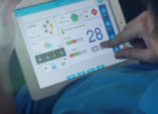





How “GREENHOUSE” will help from Extravagance to be Resourceful
Register/Login
Reduce CO2 emission
No wastage / burning, convert to Biogas
Crop to harvest / good & bad pest for the crop
No wastage
Farmers seeking work
Do I get any extra information?
Convert Extravagance & Wastages
Become Resourceful
GREENHOUSE
Marketplace
Purchase
Sell
Helping Hand
Farming Opportunities
Donate
Account with resourcefulness profile
Bio Coin
Car Pool Receipt
Recommendations
Pest Identification
Crop Suggestions
Useful Sections
Forum
Weather Forecast
Individual Credit Sheet
Green Credit
Greed Credit

Slide 6




Technologies Used
K
IBM Kubernetes
User
React JS
Django
Crop Suggestion – Watson Studio, ML service
Pest Identification – IBM COS
Frontend
Backend
Request Type
Weather Forecast – IBM Weather API
Invoice Verification – IBM MAX-OCR
Marketplace, Helping Hand, Forum, Account
Database
PostgreSQL
PostgreSQL
GitHub URL
https://github.com/Bharath3697/WiT_Hackathon
NGINX

Slide 7
Roadmap of Future Enhancements
CURRENT IMPLEMENTATION
Use ola merchant and ZOOP API's to validate the OLA receipt and electricity bill
Transit from self service to e-commerce – for Marketplace
Bring in Blockchain technology for transactions/wallet
Expand the data repository for the pest identification (harmful/harmless pests)
Identify and recommend crop disease and pests
Enhance weather forecast features (flood, cyclone warning)
Identify GreenHouse Adoption Profile. Recommend individual Credit sheet
FINAL APPLICATION

Slide 8
Benefits
Generate awareness
Convert waste products to cheap, eco friendly energy. Generate income.
Philanthropic approach to society by redistributing surplus food/clothes to the under privileged
Minimize the environmental degradation
Identify self resourcefulness towards environment and society

Slide 9
Team Turbo Dynamic
Papia Ghosh Majumdar
papmajum@in.ibm.com
Bharath K
bharatk7@in.ibm.com
Manoj Agnihotram
vikhagni@in.ibm.com

